Slide 1

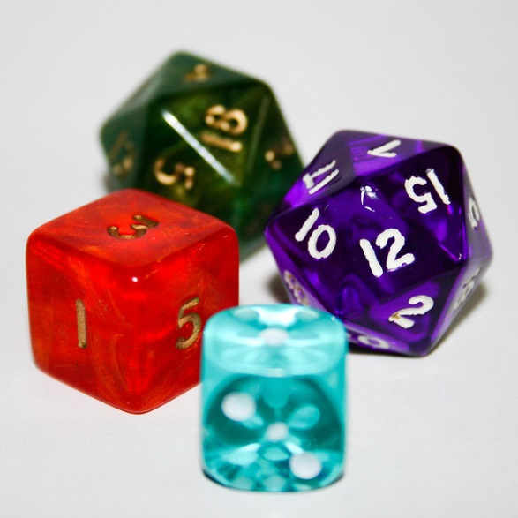

My Probability Interactive Notebook
Name
Class
Teacher Mr Evans
Term 2 Semester 1
1

Slide 2
Create your own front page
It needs to contain the following –
My number interactive notebook
Name
Class
Teachers Name
Semester 1 Term 1
Page number 1

Slide 3
Contents
Glossary or Formula Page
Page
Date
Description
2
3

Slide 4
Tasks
24
7
30
Essential Question
Questions
Notes
Summary
4
5

Slide 5
24
7
30
Date
Dependent and Independent Events
EQ – What are dependent and independent events?
The study of probability mostly deals with combining different events and studying these events alongside each other. How these different events relate to each other determines the methods and rules to follow when we're studying their probabilities.
5

Slide 6
24
7
30
Date
Dependent and Independent Events
EQ – What are dependent and independent events?
The study of probability mostly deals with combining different events and studying these events alongside each other. How these different events relate to each other determines the methods and rules to follow when we're studying their probabilities.
Events can be placed into two major categories, dependent or Independent events.
5

Slide 7
24
7
30
Date
Dependent and Independent Events
EQ – What are dependent and independent events?
The study of probability mostly deals with combining different events and studying these events alongside each other. How these different events relate to each other determines the methods and rules to follow when we're studying their probabilities.
Events can be placed into two major categories, dependent or Independent events.
What is an Independent event?
Independent Events
When two events are said to be independent of each other, what this means is that the probability that one event occurs in no way affects the probability of the other event occurring. An example of two independent events is as follows; say you rolled a die and flipped a coin. The probability of getting any number face on the die in no way influences the probability of getting a head or a tail on the coin.
5

Slide 8
24
7
30
Date
Dependent and Independent Events
EQ – What are dependent and independent events?
What is an Independent event?
Independent Events
When two events are said to be independent of each other, what this means is that the probability that one event occurs in no way affects the probability of the other event occurring. An example of two independent events is as follows; say you rolled a die and flipped a coin. The probability of getting any number face on the die in no way influences the probability of getting a head or a tail on the coin.
What is a dependent event?
Dependent Events
When two events are said to be dependent, the probability of one event occurring influences the likelihood of the other event.
For example, if you were to draw a two cards from a deck of 52 cards. If on your first draw you had an ace and you put that aside, the probability of drawing an ace on the second draw is greatly changed because you drew an ace the first time. Let's calculate these different probabilities to see what's going on.
5

Slide 9
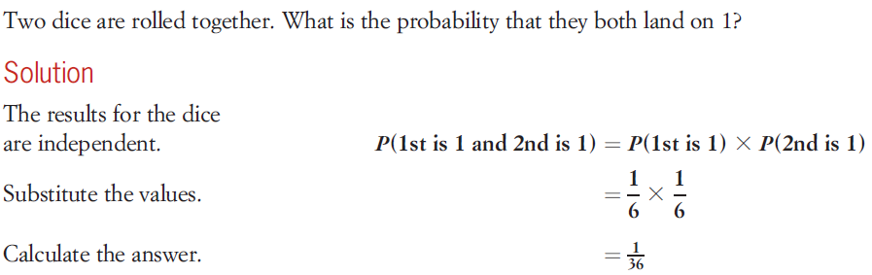
24
7
30
Date
Dependent and Independent Events
EQ – What are dependent and independent events?
How do we find the probability of two independent events?
Probability of a combination of independent events
The probability of two independent events A and B both occurring is the product of their individual probabilities.
For independent events A and B, P(A and B) = P(A) X P(B).
Example
5

Slide 10
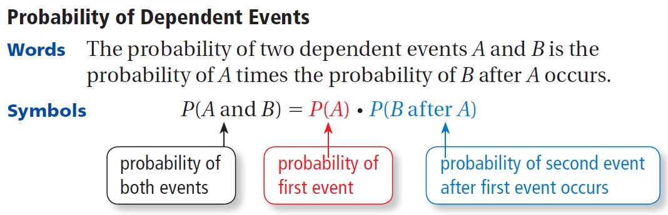
24
7
30
Date
Dependent and Independent Events
EQ – What are dependent and independent events?
How do we find the probability of dependent events?
Example
5

Slide 11
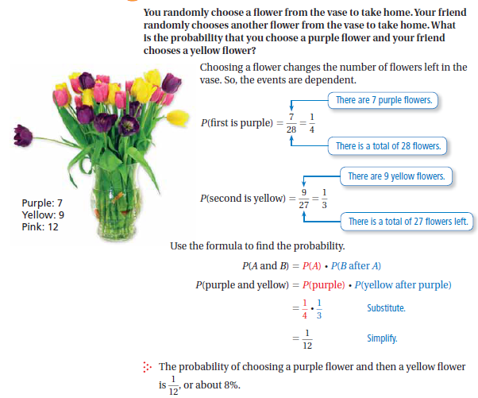
24
7
30
Date
Dependent and Independent Events
EQ – What are dependent and independent events?
How do we find the probability of dependent events?
Example
5

Slide 12
Task
Complete the worksheet provided.

Slide 13
Notes Review
24, 7 ,30
Date
Title
Essential question
Notes complete
Notes complete with colour and diagrams
Questions completed
Contents page filed in
Formula page filled in

Slide 14
Homework
Review your notes and write a summary answering the essential question.

